Slide 1
Filed controlled DC motor
Presented by: Kshitij Kumar Sharma (1905514)

Slide 2
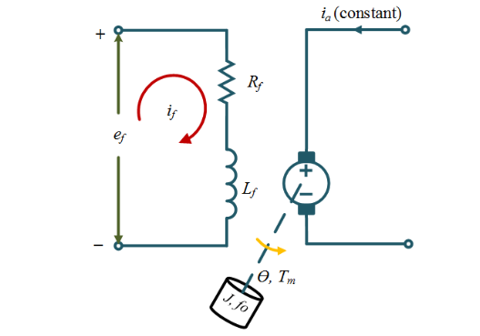
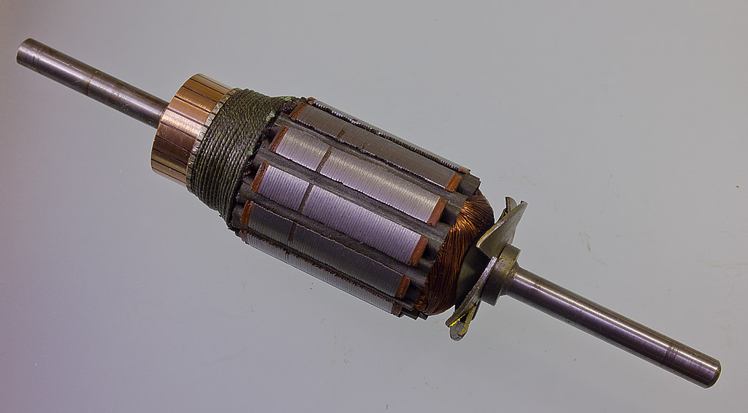
What is field controlled DC motor
The speed of a DC motor is directly proportional to armature voltage and inversely proportional to flux. In field controlled DC motor the armature voltage is kept constant and the speed is varied by varying the flux of the machine. Since flux is directly proportional to field current, the flux is varied by varying field current
Kshitij Kumar Sharma (1905514)

Slide 3
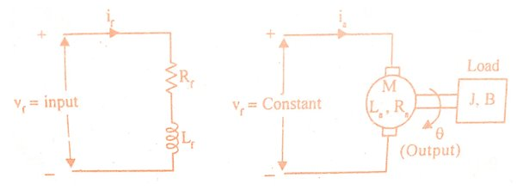
Transfer function of Field controlled DC motor
The speed control system is an electro-mechanical control system. The electrical system consists of armature and field circuit but for analysis purpose, only field circuit is considered because the armature is excited by a constant voltage. The mechanical system consists of the rotating part of the motor and the load connected to the shaft of the motor. The field controlled DC motor speed control system is shown in the below figure.
Let Rf = Field resistance , Lf = Field inductance
if = Field current
Vf= Field voltage
T = Torque developed by motor
Kt = Torque constant, J = Moment of inertia of rotor and load
B = Frictional coefficient of rotor and load
Kshitij Kumar Sharma (1905514)

Slide 4
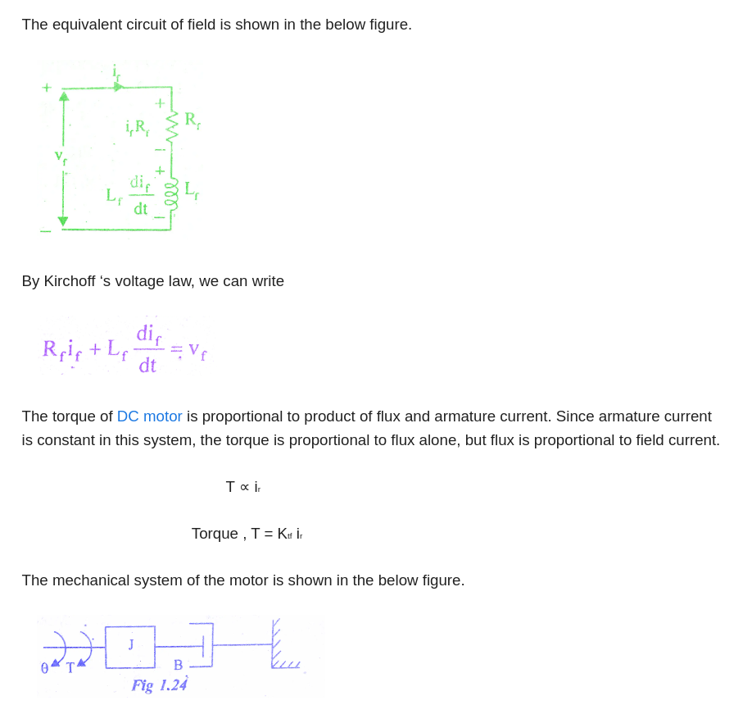
Kshitij Kumar Sharma (1905514)

Slide 5
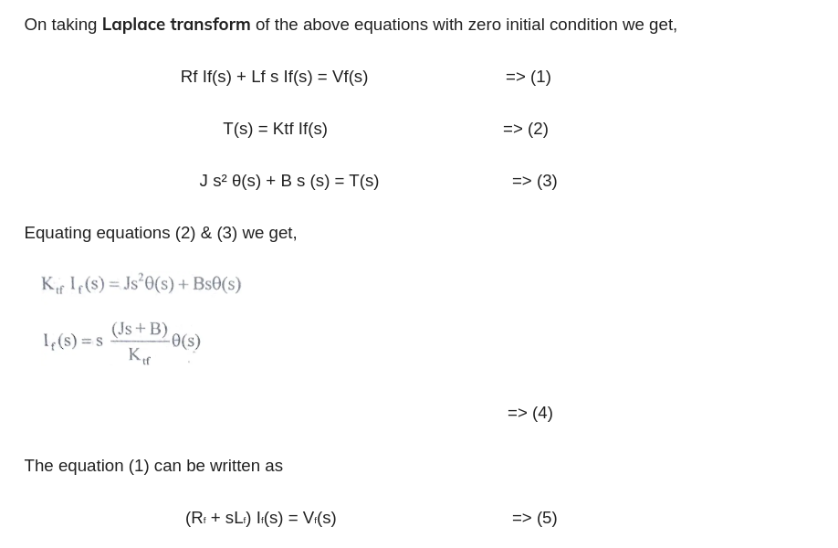
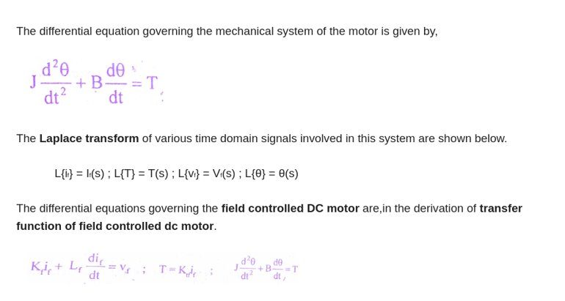
Kshitij Kumar Sharma (1905514)

Slide 6
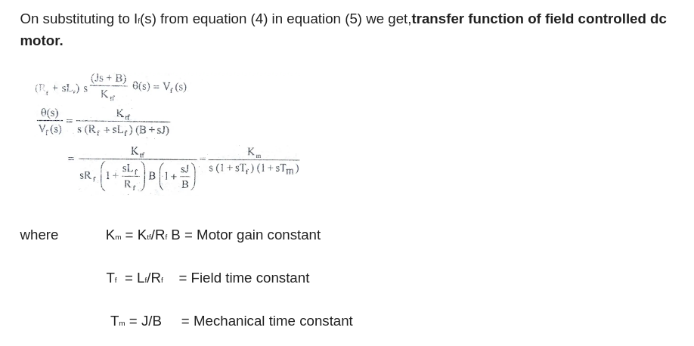
Kshitij Kumar Sharma (1905514)

Slide 7
Applications of Field controlled DC motor
As an open loop system, the field control method is ideal for operators who need cost-effectiveness, smooth performance and steady output. Field controlled DC motors are more common for longer processes due to their reliability and convenience. Unlike armature controlled motors, field control provides speeds that are above the normal range.
There are three category of motors which are used in field controlled mode for different purpose and they are as follows:
Filed controlled DC servo motor
Brushless motor
Industrial application motor
Kshitij Kumar Sharma (1905514)

Slide 8
Applications of Field controlled DC servo motor
Servo motors are used for exact speed, torque, and positioning of driven machines. Because speed is the major parameter, the speed of the rotating magnetic stator field is controlled. It has a wide variety of applications such as:
In metal cutting and forming machines.
In rotary or linear actuators that rotate and push parts of a machine with precision.
used as prime movers in computers, numerically controlled machinery, or other applications where starts and stops are made quickly and accurately.
used in robotics to activate movements, giving the arm to its precise angle.
used to start, move and stop conveyor belts carrying the product along with many stages. For instance, product labeling, bottling and packaging.
The servo motor is built into the camera to correct a lens of the camera to improve out of focus images.
The servo motor is used in solar tracking system to correct the angle of the panel so that each solar panel stays to face the sun.
The Servo motor is used in automatic door openers to control the door in public places like supermarkets, hospitals and theatres.
Kshitij Kumar Sharma (1905514)

Slide 9
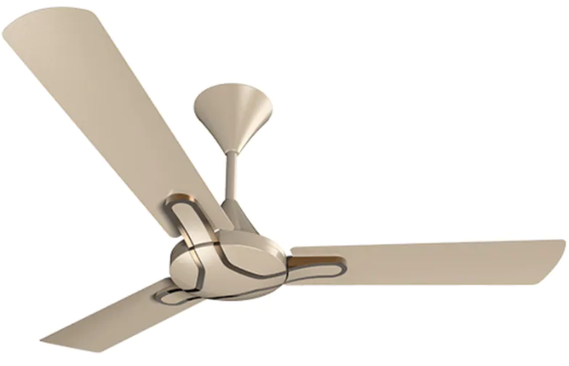
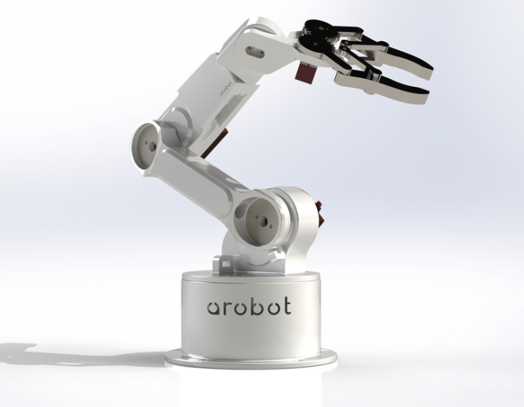
Applications of Brushless DC motor
The absence of brushes reduces the frequent replacement of brushes which reduces the maintenance cost. A Brushless DC motor has high-level control over the speed and position of the motor. The lifespan of a Brushless DC motor is higher than the brushed DC motor. A Brushless DC motor provides high torque to speed ratio which is best suited for robotics and medical applications. As there are no brushes it produces less operating noise. Few of its applications are as follows:
Brushless DC motors are used in hybrid vehicles, electric vehicles, and other electrical equipment.
These motors are used in robotics for robotic arms.
BLDC motors are used in computer hard drives and DVD players.
These motors are used in fans, washing machines, dryers, pumps, blowers, and compressors.
Most of the high speed medical equipment are made up of BLDC motor.
Kshitij Kumar Sharma (1905514)

Slide 10
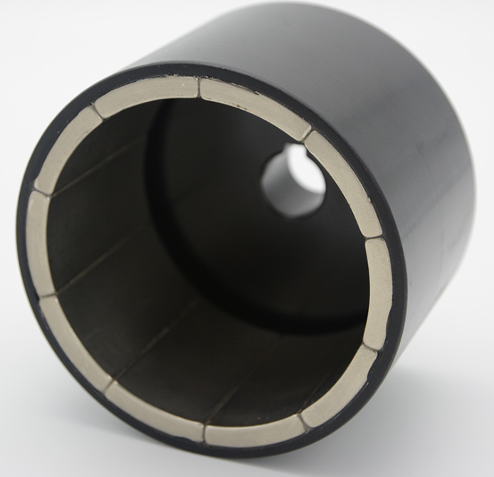
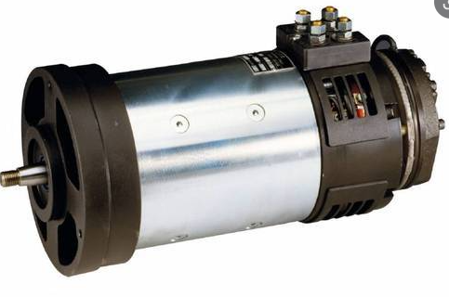
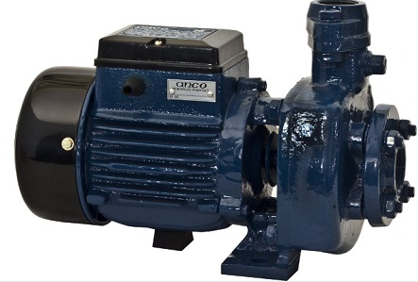
Industrial DC motor
There are variety of DC motors used for industrial purpose and they are as follows:
Permanent Magnet DC Motor (PMDC Motor)
Separately Excited DC Motor
Self-Excited DC Motor
Shunt Wound DC Motor
Series Wound DC Motor
Compound Wound DC Motor
Short shunt DC Motor
Long shunt DC Motor
Kshitij Kumar Sharma (1905514)

Slide 11
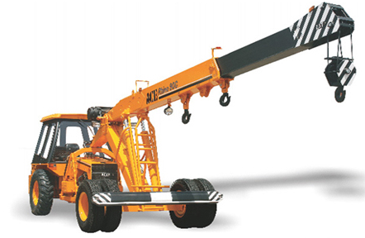
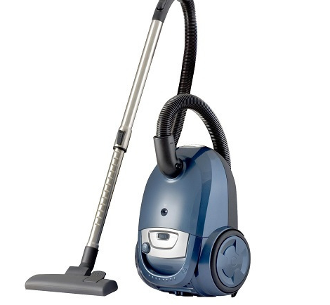
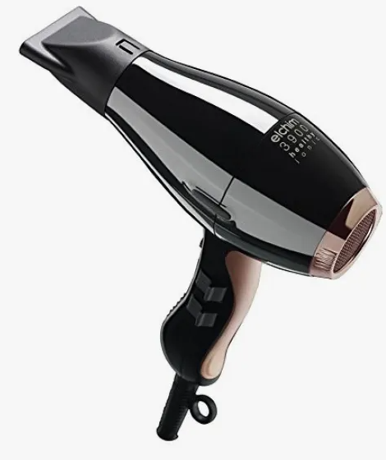

Application of DC series motor
DC series motor is suitable for both high and low power drives, for fixed and variable speed electric drives. This type of motor has simple construction. Also, it is easy for design and maintenance. following are its few applications:
Cranes
Air compressor
Lifts
Elevators
Winching system
Electric traction
Hair drier
Vacuum cleaner and in speed regulation application
power tools
Sewing machine
Electric footing
Kshitij Kumar Sharma (1905514)

Slide 12
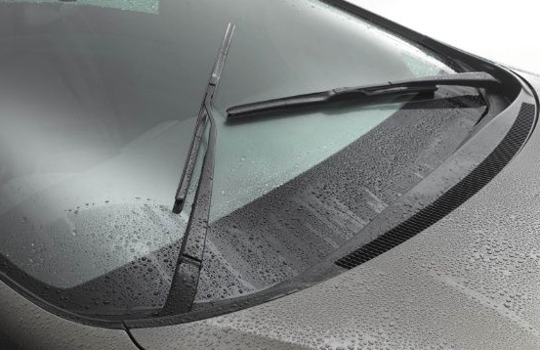
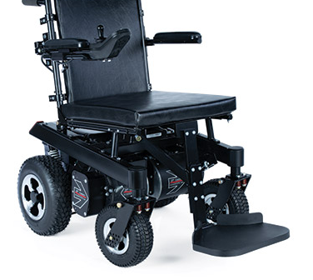
Application of permanent magnet DC motor
The permanent magnet DC motor is the special type of motor where we use a permanent magnet to create the required magnetic field. As this motor does not need to control the speed, it uses in the applications like:
Washer
Windshield wiper
Automobiles as a starter motor
Personal computer disc drives
Toys
Wheelchairs
Blowers in heater and air conditioners.
Kshitij Kumar Sharma (1905514)

Slide 13
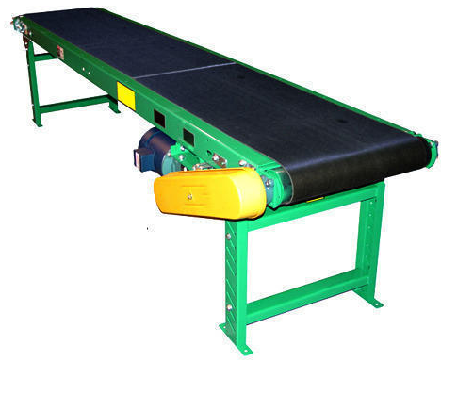
Application of compound DC motor
There are two types of Compound DC motor.
Differential and other is
Cumulative compound motor.
The differential compound motor has poor torque characteristics because the motor increases the speed with increase in load. so this motor is not suitable for any practical application.
On the other hand, the cumulative compound motor has high starting torque characteristic. Also, it has good speed regulation at high speed so it uses in:
Presses
Electric shovels
Reciprocating machine
Conveyors
Stamping machine
Elevators
Compressors
Rolling mills
Heavy planners
Kshitij Kumar Sharma (1905514)

Slide 14

Thank You
-By Kshitij Kumar Sharma (1905514)

